Slide 1
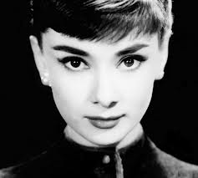
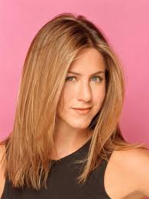
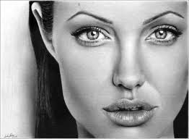
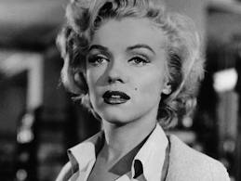
Exploring Katniss
Starter: In your opinion, list the three most famous men and the three most famous women in the world. Looking at your list, what are these people famous for? Is there a difference for the men and the women?
Challenge :
Can you draw any conclusions about what is needed for a women to become famous?
“From my list, I can tell that to be a famous women you need to be ____ ”
Notes:
1

Slide 2


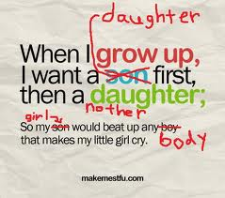
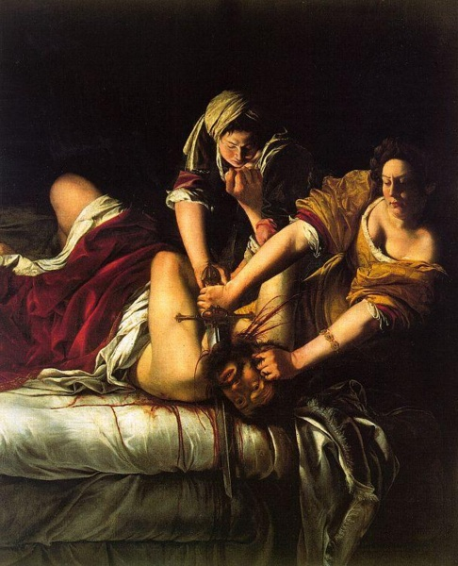


I googled a word and the following pictures appeared. What was it ?
What is feminism ?
Notes:
2

Slide 3
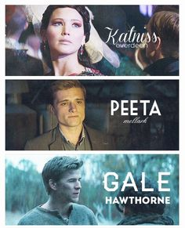

Chapter 21

Slide 4

Learning Question: What is feminism?
What is feminism ?
Task: List some of the stereotypes associated with women?
1. What does the theme of feminism have to do with the Hunger Games? In what ways does The Hunger Games subvert these stereotypes ?
Challenge: Can you think of any other examples of popular icons who could be considered feminist?
Challenge: Do we still need feminism in our society?
Notes:
Answer questions in books

